Slide 1
Digital Communication Project

Slide 2
Name | ID
سيمون جوزيف شحاته عبدالملاك | 18010835
نورهان محمد جابر | 18012017
مارينا فؤاد عزيز | 18011310
يسرا ناصر شرف محمد | 18012095
ريم محمد عبد الكامل | 18010700
اسماء جمال عبدالحليم مبروك | 15010473
احمد محمد احمد عبدالجواد | 18010198
محمد طارق عامر | 1801505
احمد محمد ابوجبل | 18010200

Slide 3
Part 1: ISI due to band-limited Channels

Slide 4
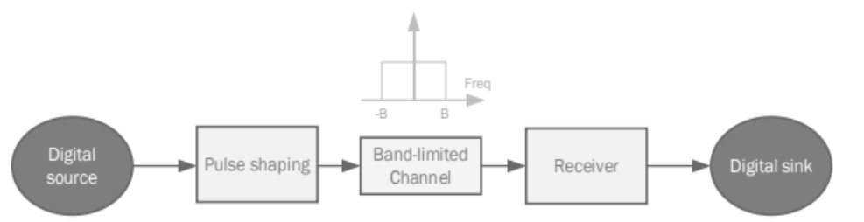
Part 1: ISI due to band-limited Channels

Slide 5
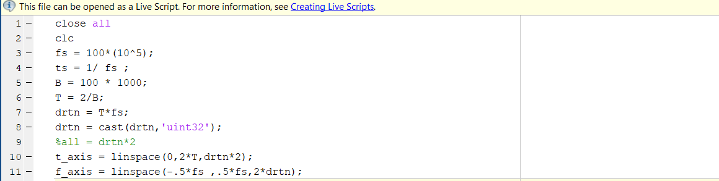
Defining variable

Slide 6
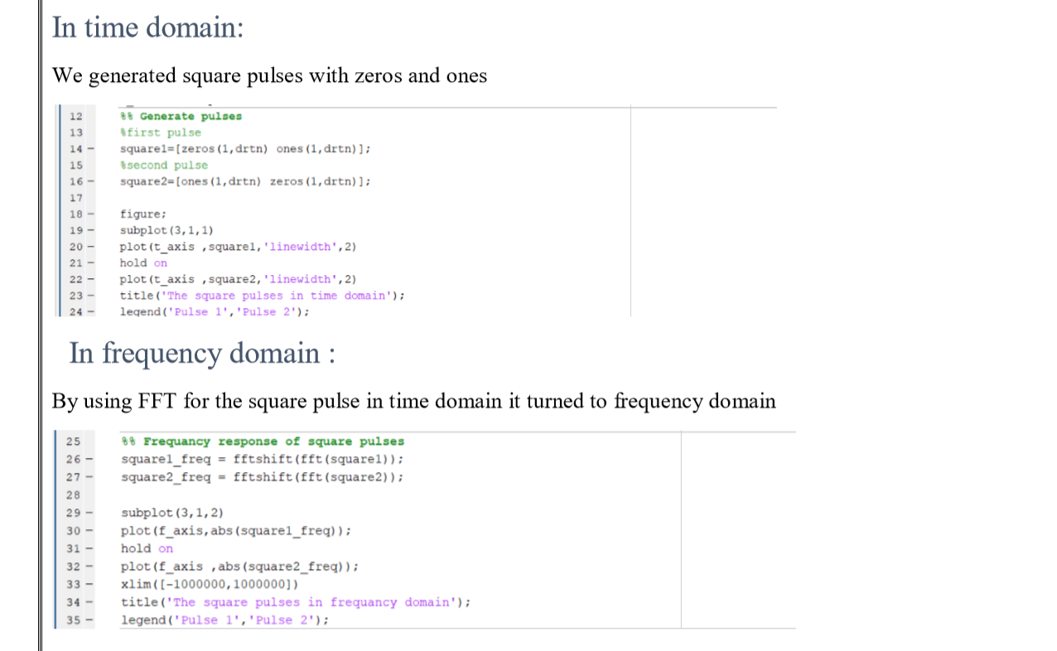
To generate square pulses

Slide 7
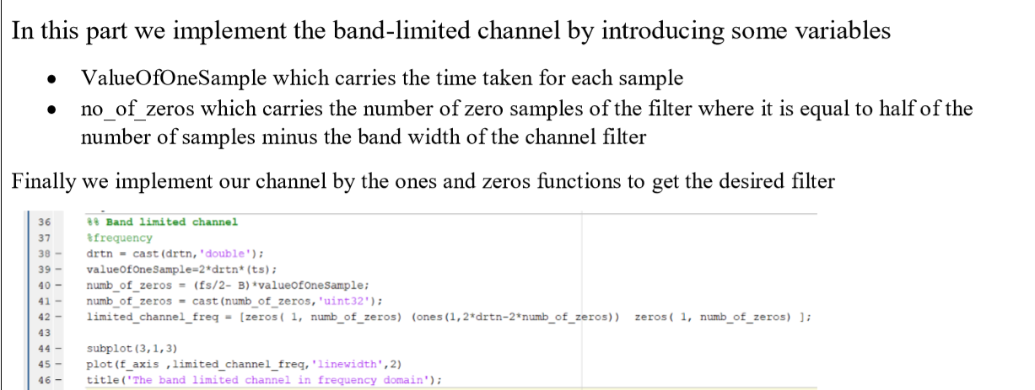
Generating the band limited channel

Slide 8
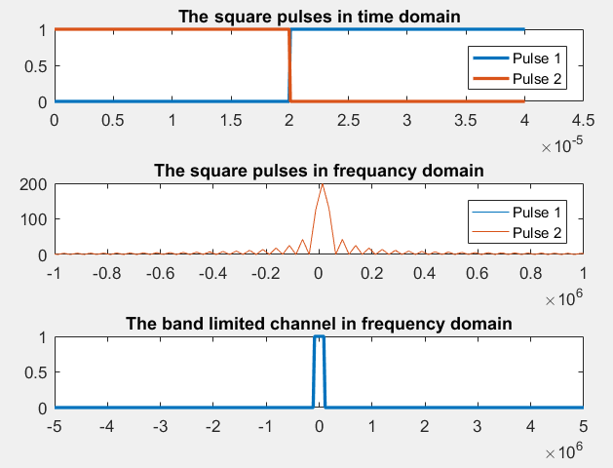
Pulse shaping and channel

Slide 9
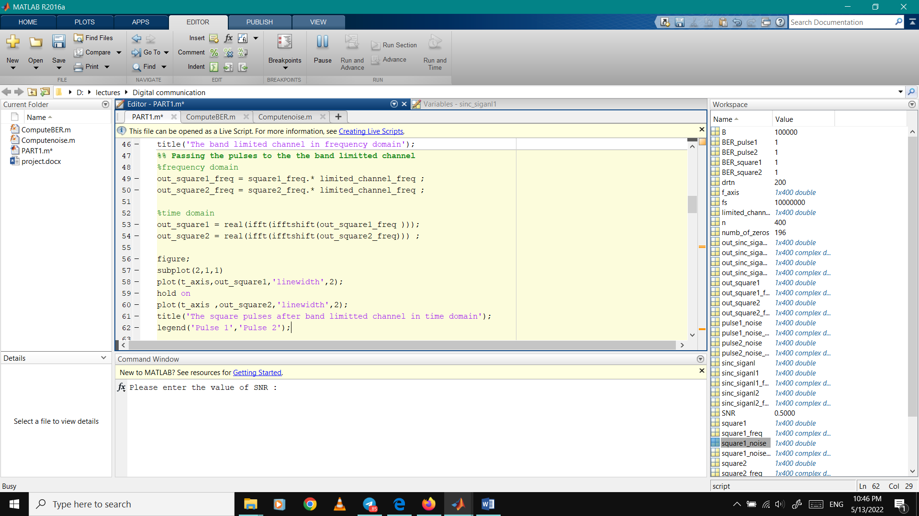
Passing pulses through band channel

Slide 10
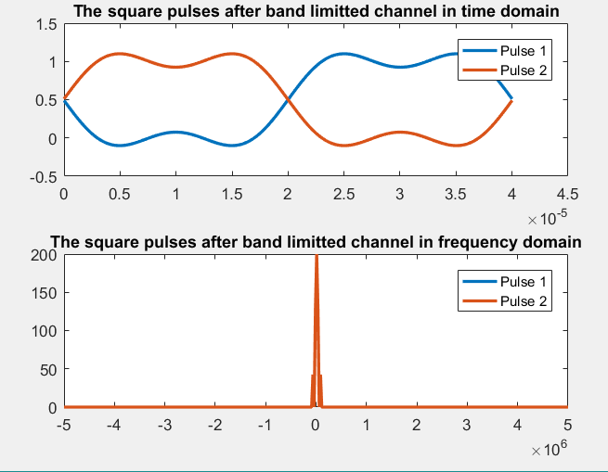
Effect of band-limited channel on the two square pulses

Slide 11
Effect of band-limited channel on the two square pulses
For nullifying the ISI terms, with an impulse of unit value applied at t=0 to the combined filters h(t) the samples of the h(t) at the output of the filter combination should be 1 at the sampling instant t=0 and zero at all other sampling instants kTb(k!=0) This is called Nyquist criterion for zero ISI.On the other hand, the signal that avoids ISI with the least amount of bandwidth is a sinc function that has zeros at t = Tb, 2Tb, 3Tb, … will also satisfy this condition.

Slide 12
Sinc pulse shaping
Raised-cosine pulse shaping
Square-root raised-cosine pulse shaping

Slide 13
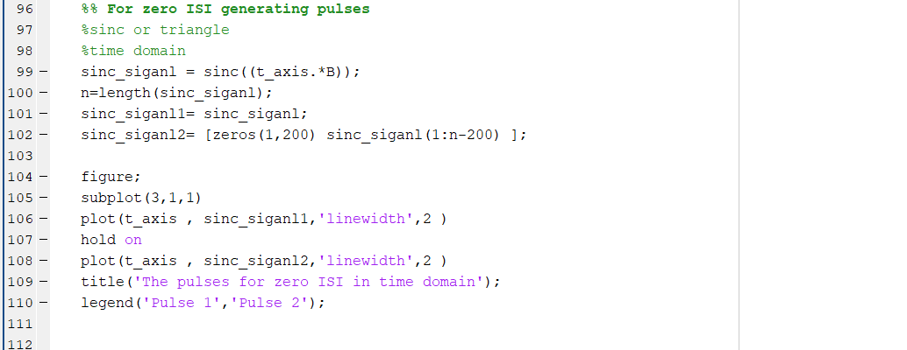
Generate sinc pulses

Slide 14
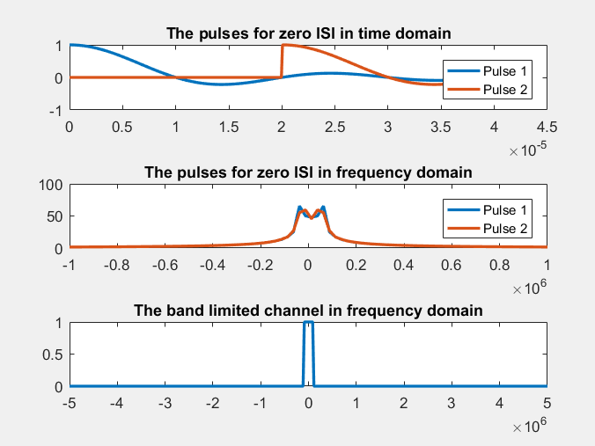
Sinc functions that ensures the criterion pulses of no ISI

Slide 15
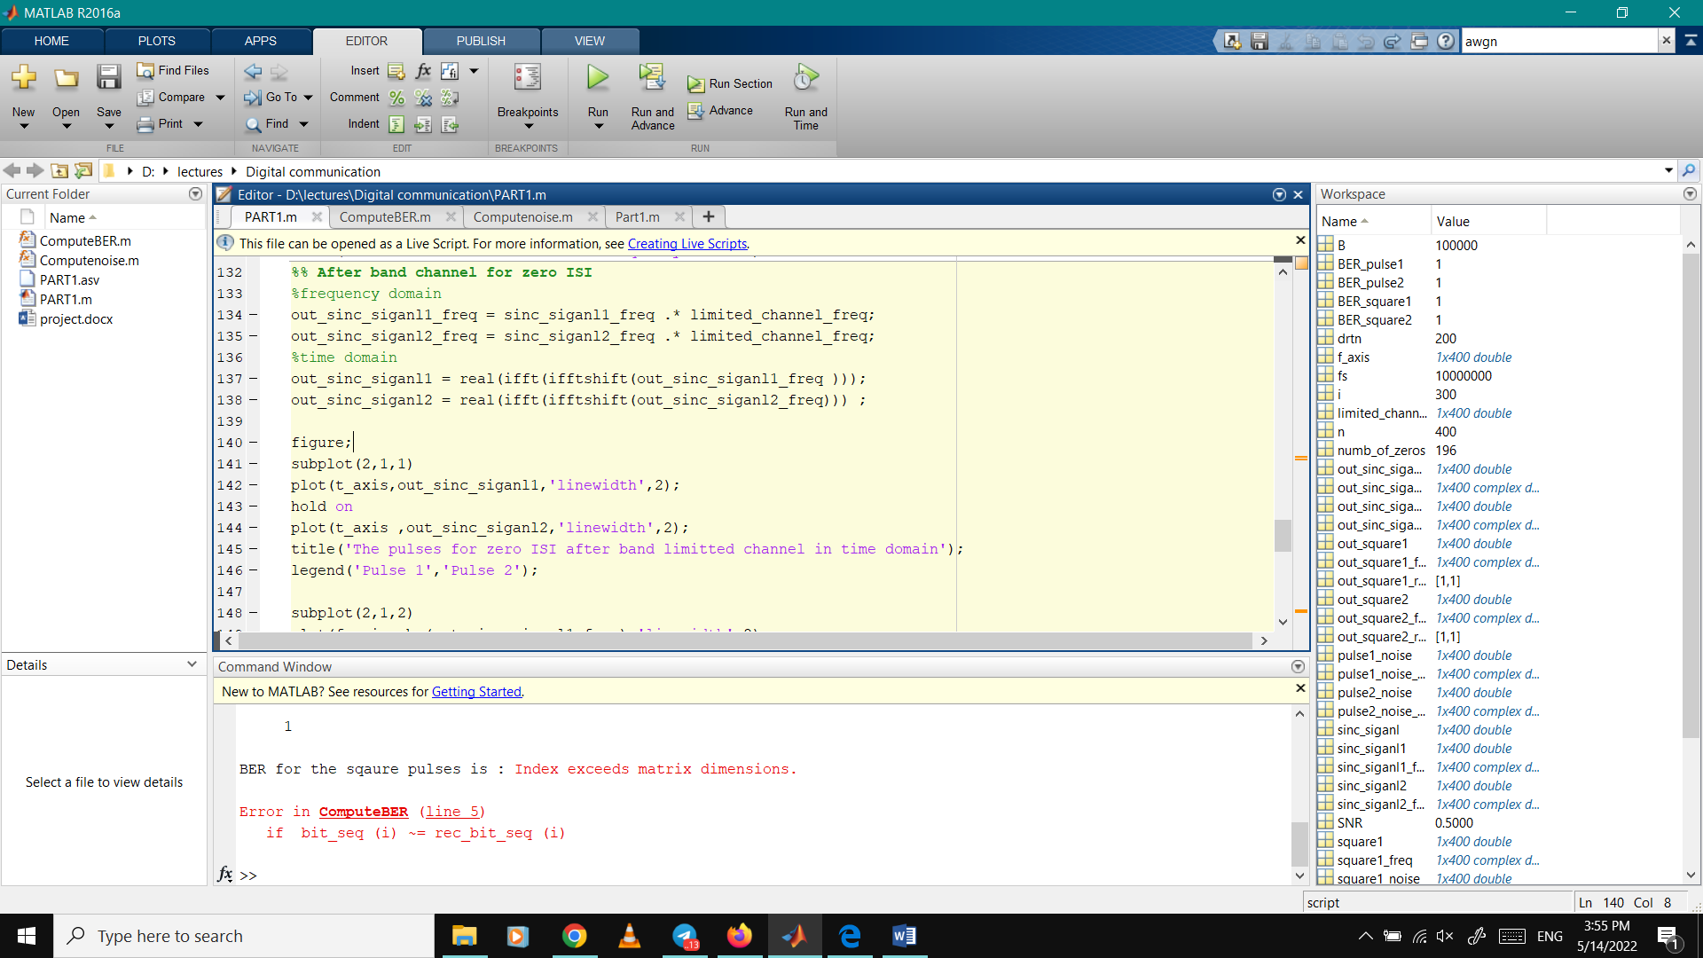
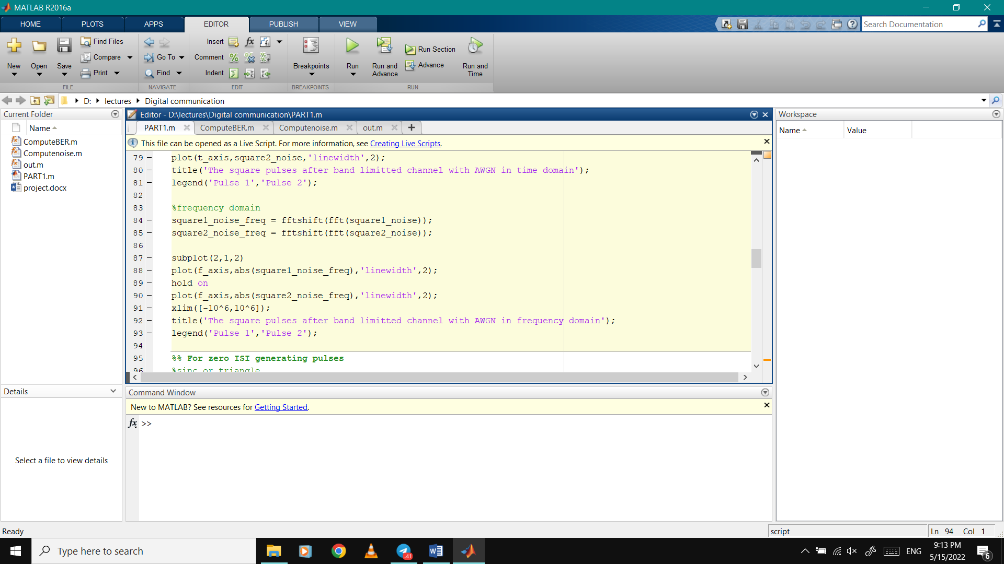
Passing through channel

Slide 16
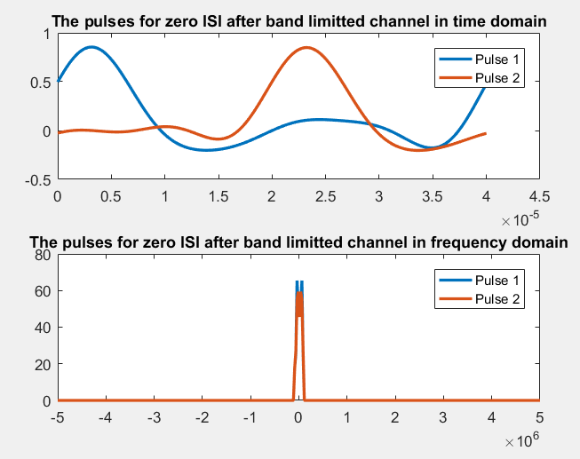
Effect of band-limited channel on the two sinc pulses pulses

Slide 17
Optional part

Slide 18
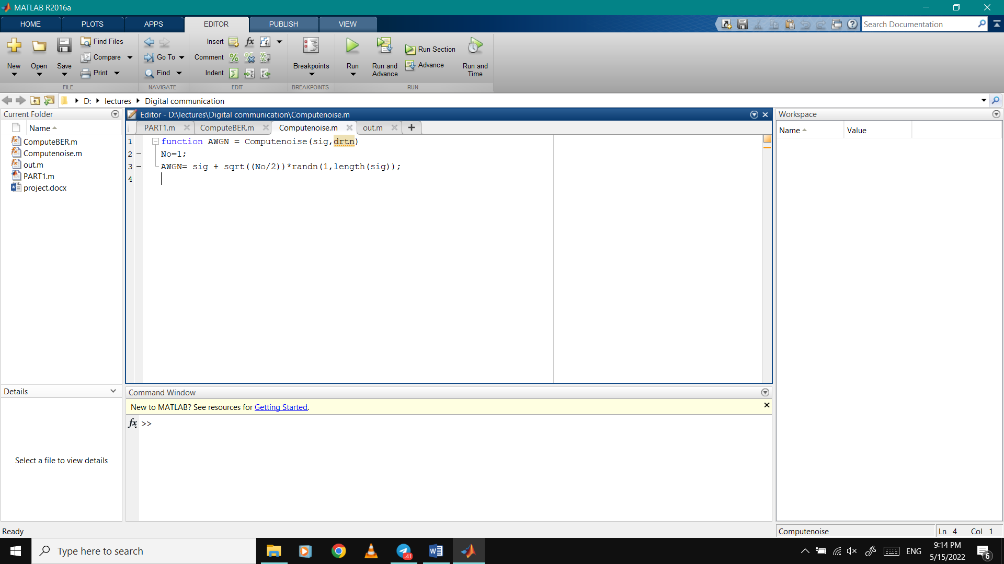
AWGN channel

Slide 19
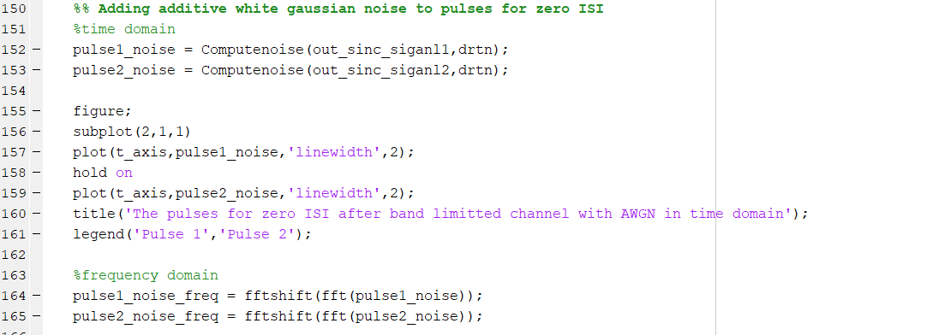
Adding noise to sinc

Slide 20
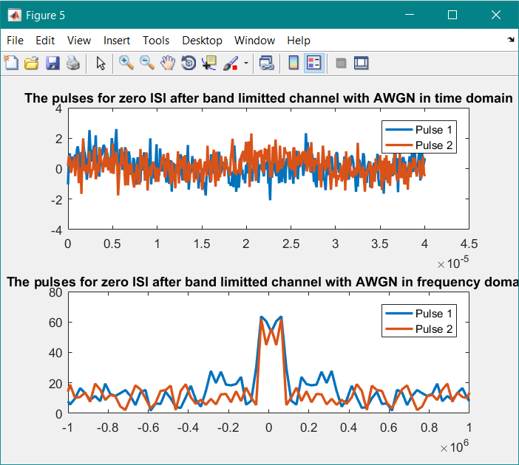

Slide 21
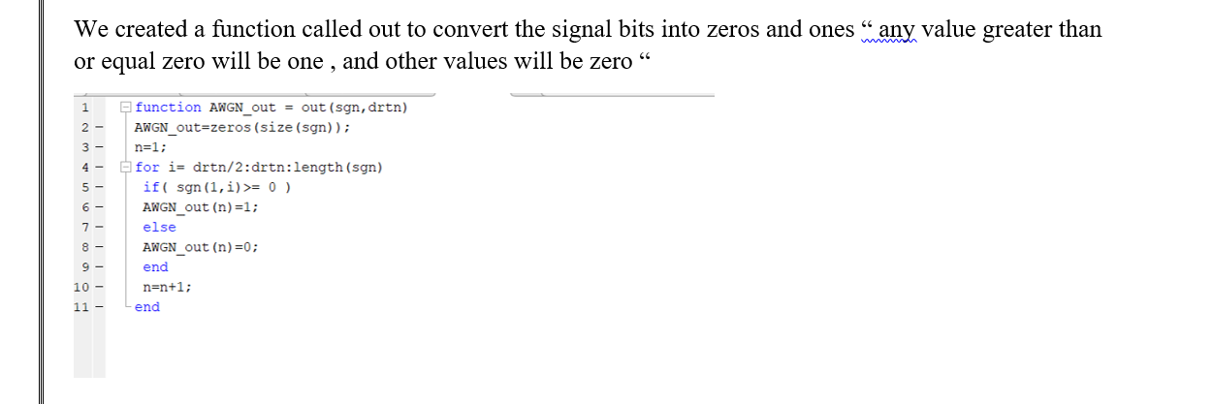
To compute BER :
first function “out”

Slide 22
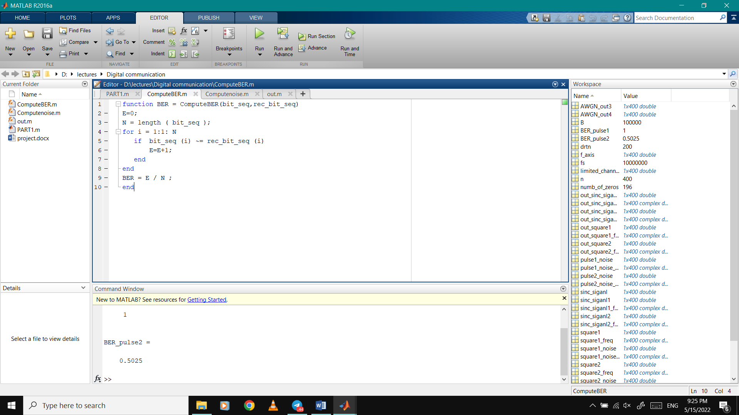
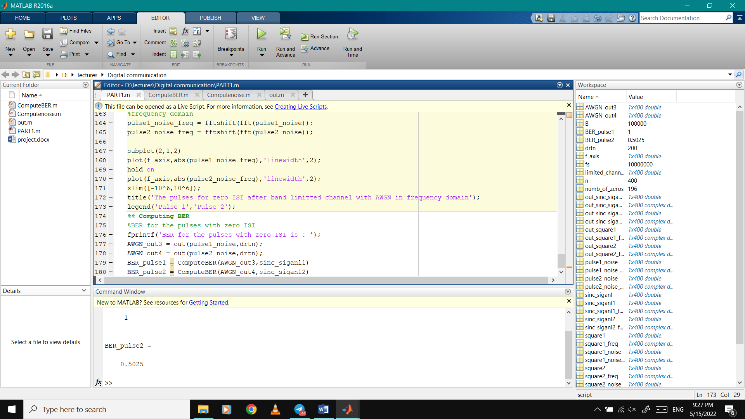
To compute BER :

Slide 23
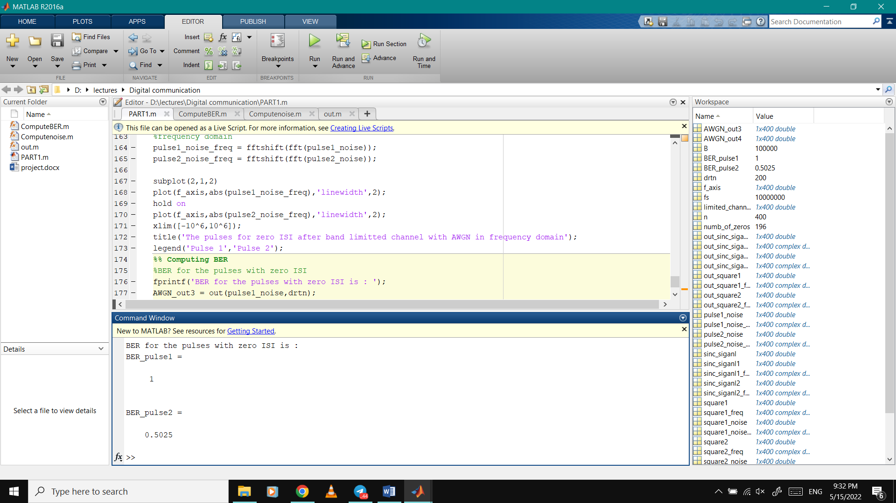
To compute BER :

Slide 24
Part (2)
Inter-Symbol Interference due to multi-path channels

Slide 25
Transmitter “Generating the signal BPSK”
Generating Random Integer between (0&1).
Converting every 0 to -1.
l = 100; %No of paths
S = randi([0,1],L,1);
A=length(S);
for i= 1 : length(S)
if S(i) == 0
S(i)= -1;
end
end

Slide 26
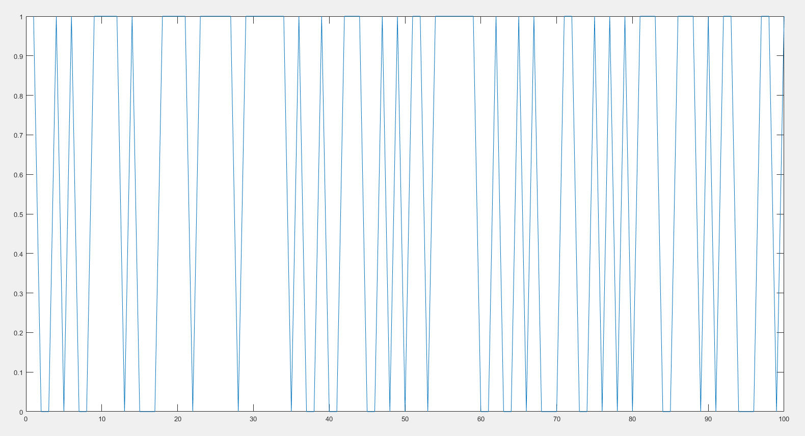
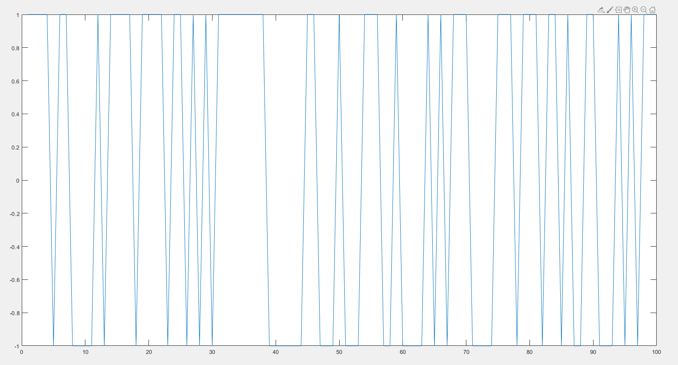

Slide 27
Channel “Due to Multipath Effect & noise”
Generating the coefficients due to the multipath effect.
Adding the noise to the system.
h = MultipathChannel(L,1);
H = tril(toeplitz(h));
V = H * S;
Eb_No_db = 0; % The specified Eb/No value in dB
Energy_per_bit = 1;
No = Energy_per_bit/( 10^(Eb_No_db/10));
noise= (randn(size(V)) + 1i*randn(size(V)))*sqrt(No/2); %generate Noise
Y = (H * S) + noise ; %getting the received signal Y

Slide 28
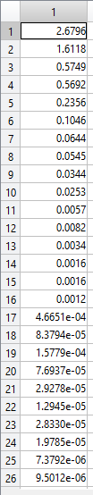
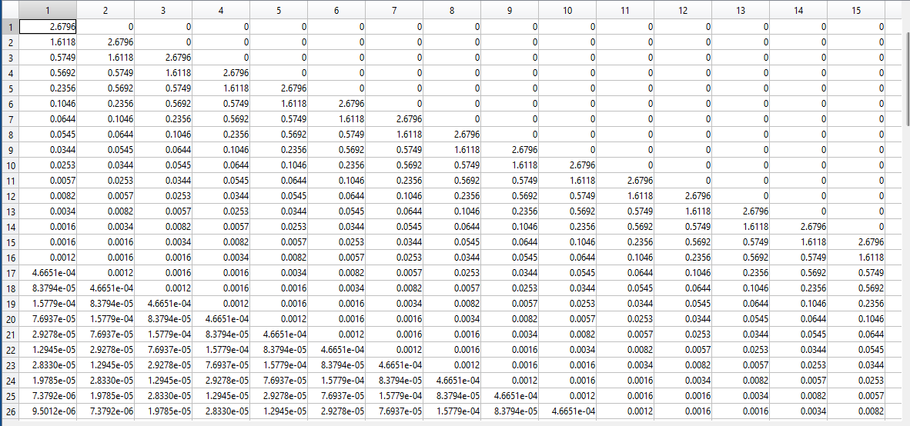

Slide 29
Estimating the output due to the channel effect
Taking the inverse of the input to the receiver.
Estimating the output of the signal if it is greater of “0” will be 1 if less than “0” will be -1.
Z= inv(H); %Equalize channel effect
X= Z * Y;
X_Estimated = zeros(l,1);
%Decision Maker
for i=1:length(S)
if X(i) > 0
B =1;
else
B=-1;
end
X_Estimated(i) = B; %Estimated_Transmitted_signal
end

Slide 30
Changing the power ratio and calculate the BER
Changing the power of the noise.
Each time we calculate the BER.

Slide 31
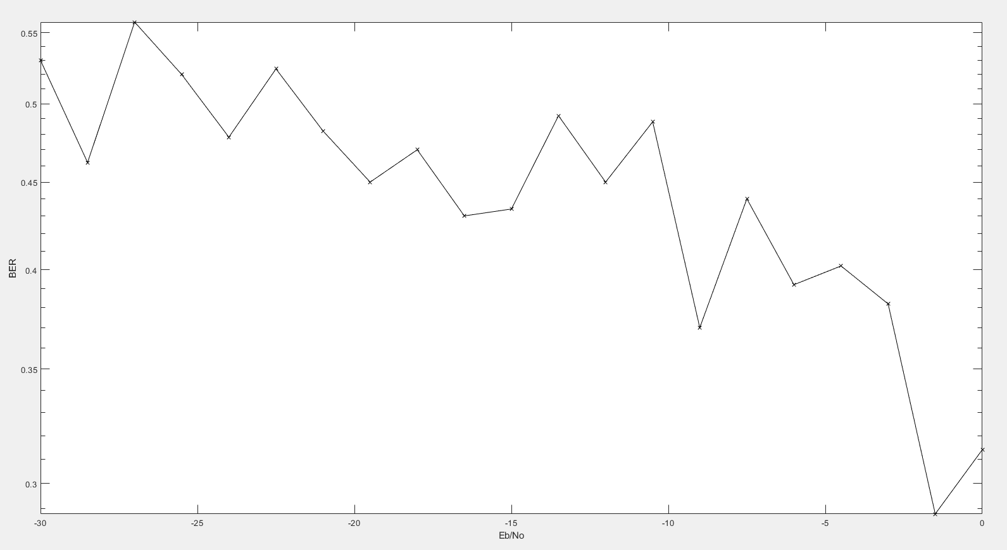

Slide 32
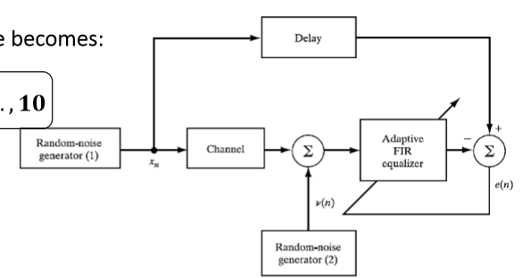
Another System to equalize the channel.
We can use the Adaptive Filters to generate the inverse of the channel.
We will use Weiner Solution.

Slide 33
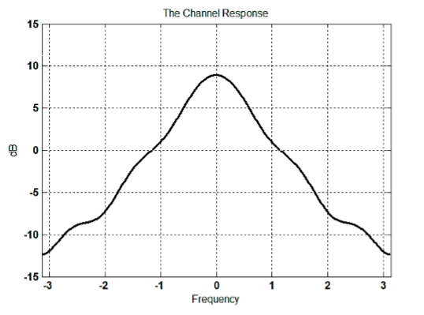
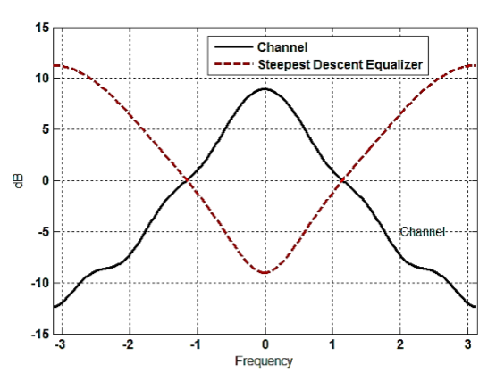
The idea behind the weiner:
If the input is like figure(1), the filter will try to get the inverse of the channel like figure (2).

Slide 34
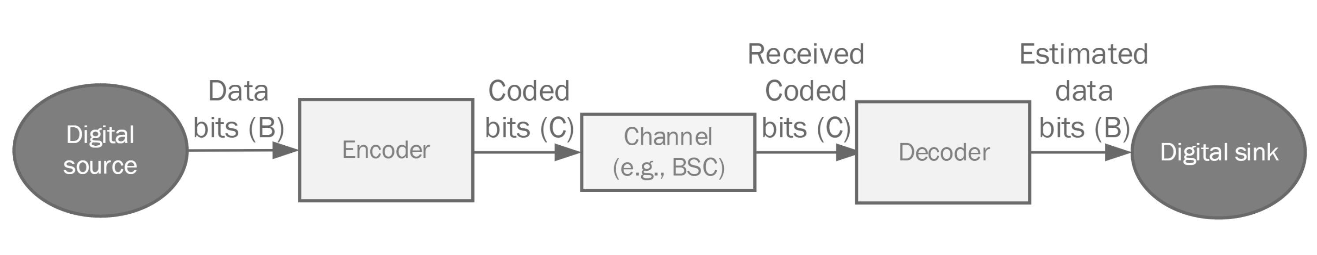
Part 3: Comparisons of coding techniques

Slide 35
In this project, we investigate the error correcting performance of different codes across a Binary Symmetric Channel (BSC) with a transition probability 0 ≤ 𝑝 ≤ 0.5. to assess the performance of these codes for different values of 𝑝
Repetation code – convolution code – polar codes

Slide 36
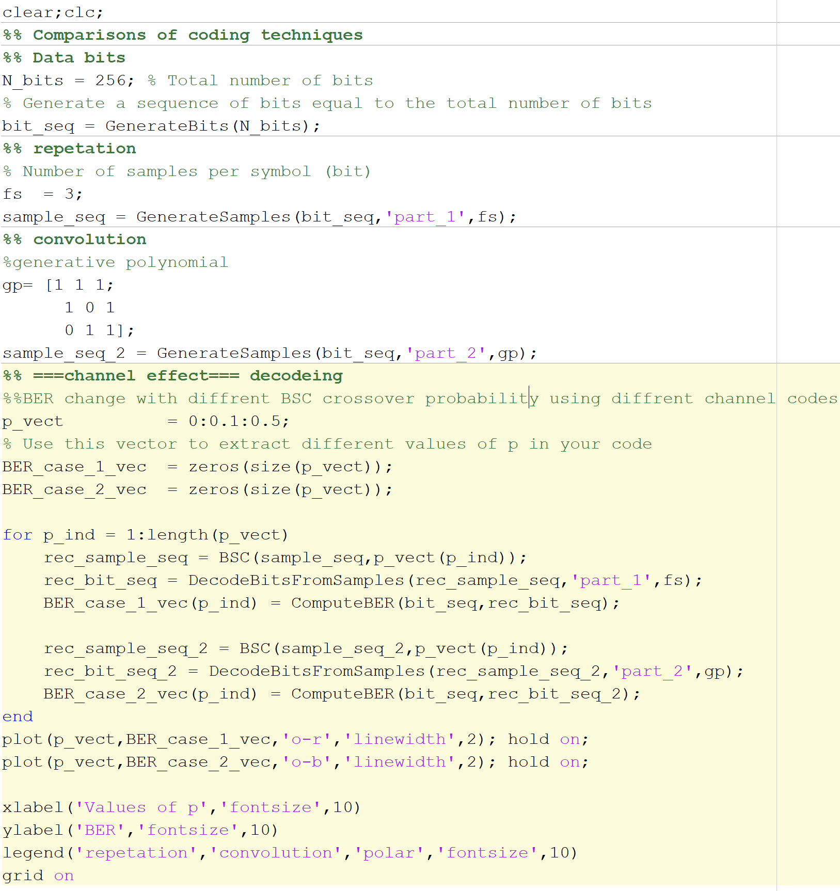
Main script all the decoders n encoders will be illustrated in it’s part here is the general structure

Slide 37
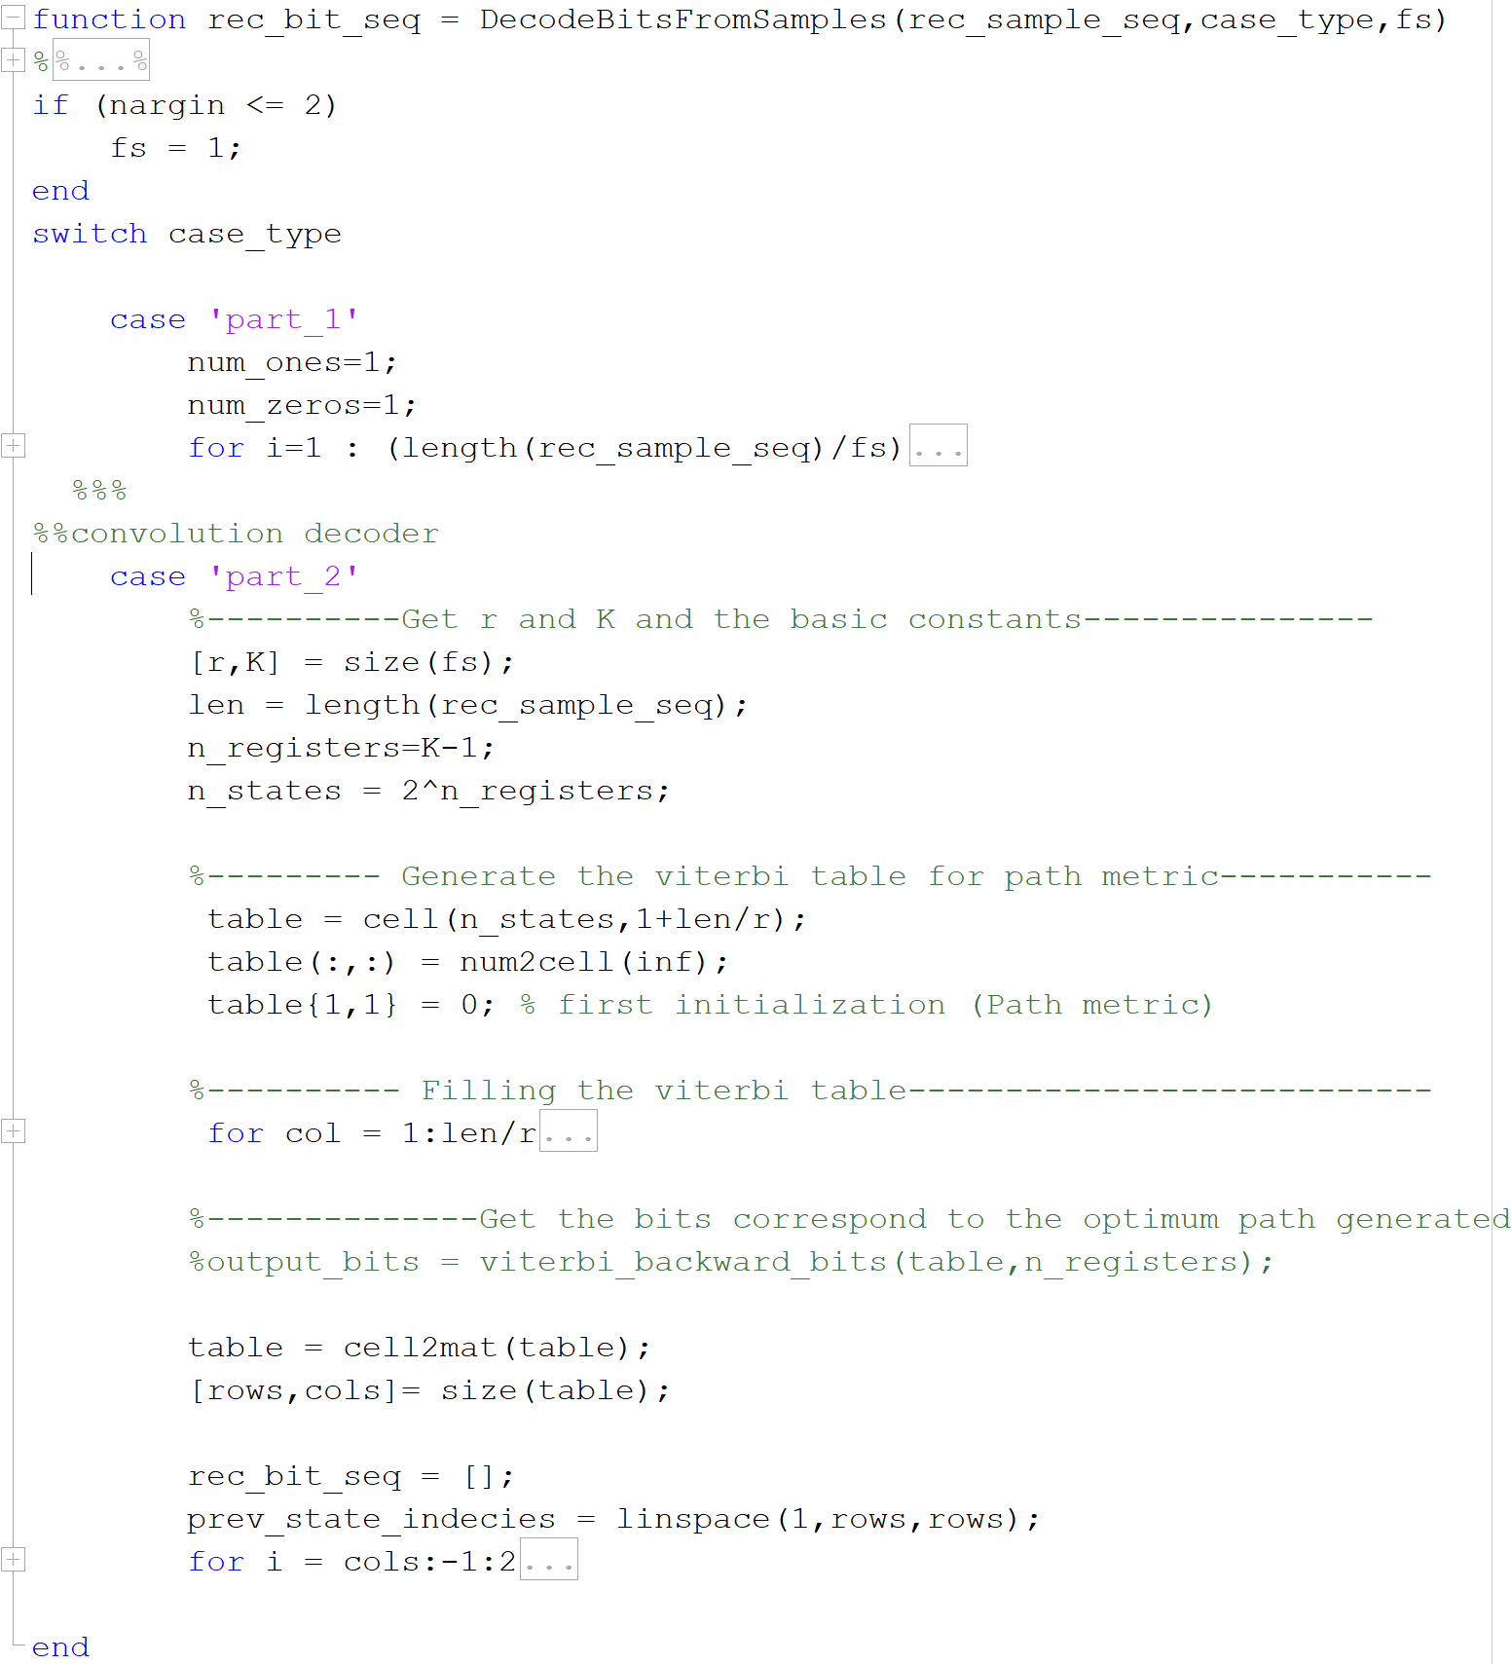
All Decoders are implemented inside this script

Slide 38
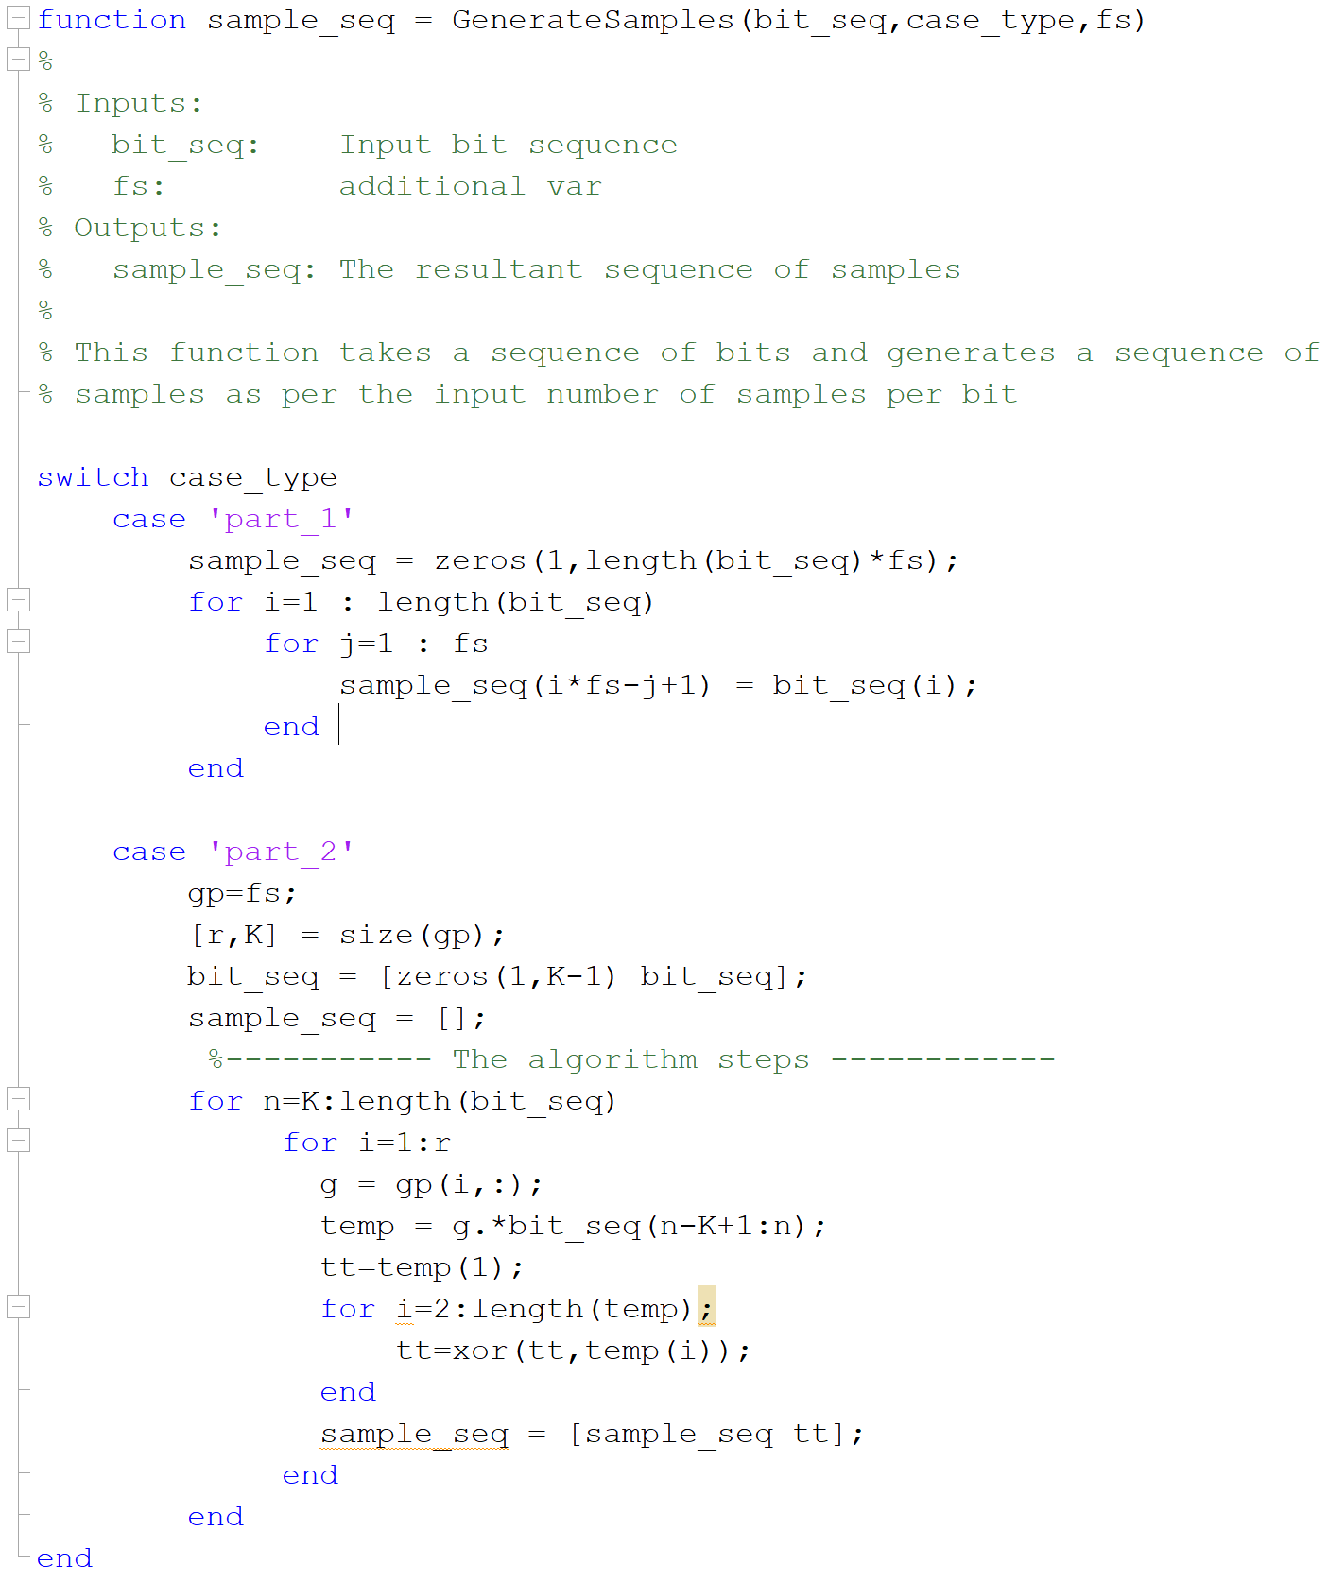
All Decoders are implemented inside this script

Slide 39
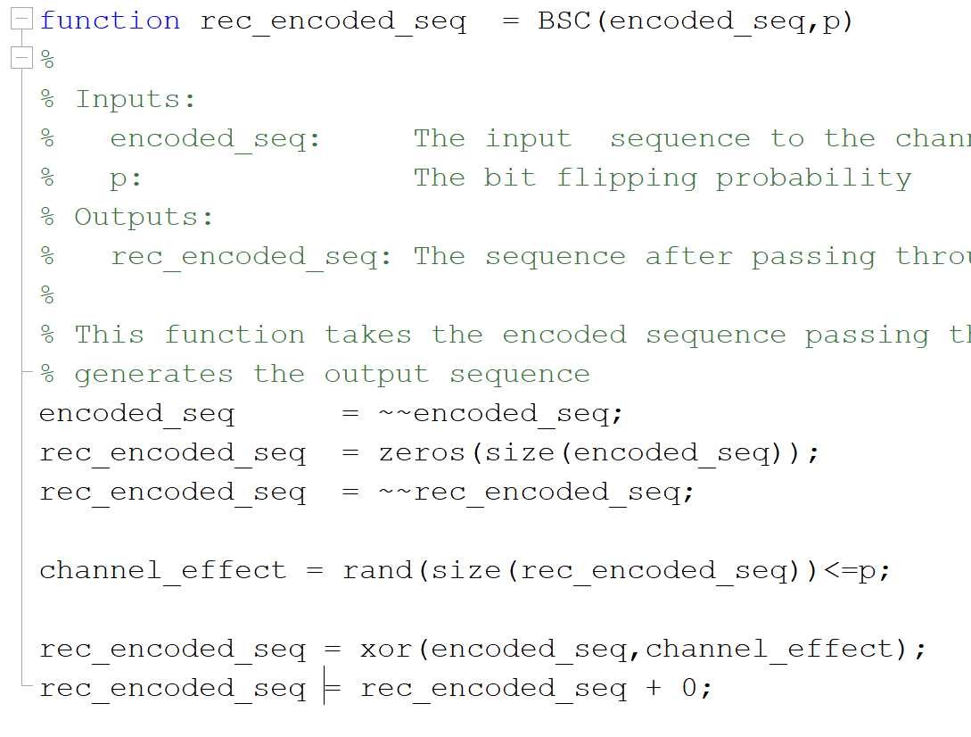
BSC

Slide 40
Repetation code
In coding theory, the repetition code is one of the most basic error-correcting codes. In order to transmIn coding theory, the repetition code is one of the most basic error-correcting codes. In order to transmit a message over a noisy channel that may corrupt the transmission in a few places, the idea of the repetition code is to just repeat the message several times. The hope is that the channel corrupts only a minority of these repetitionsit a message over a noisy channel that may corrupt the transmission in a few places, the idea of the repetition code is to just repeat the message several times. The hope is that the channel corrupts only a minority of these repetitions
The chief attraction of the repetition code is the ease of implementation.
the minimum Hamming distance of the code equals its length . This gives the repetition code an error correcting capacity of errors in any code word)
. If the length of a binary repetition code is odd, then it's a perfect code.

Slide 41
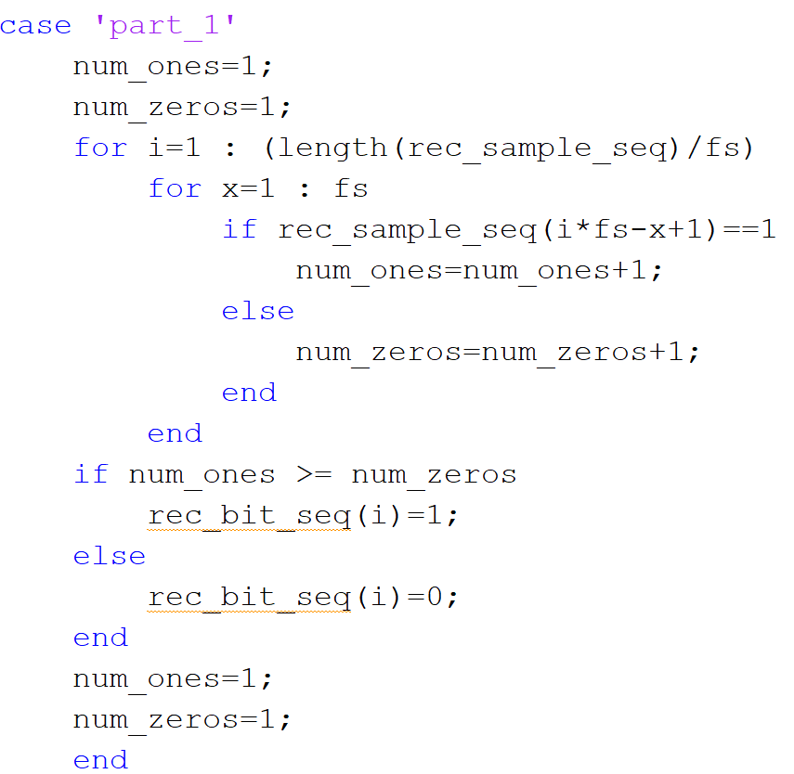
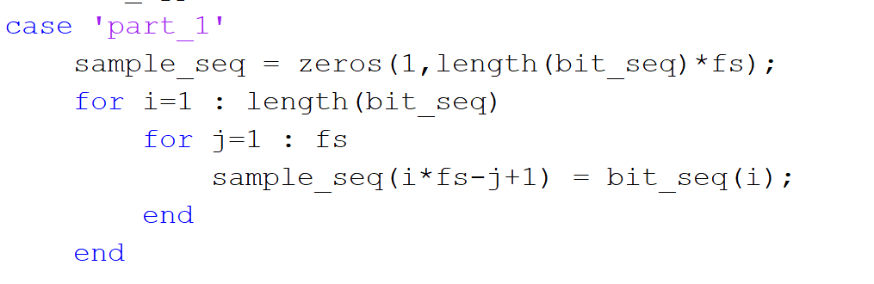
Here is a simulation for using repetation code for the transmitted data using matlab
Decoder
Counts the L bits for each bit and decides upon than either it’s 0 or 1
Encoder
Very simple all about repeting every bit with L times as L=1/r :r→rate

Slide 42
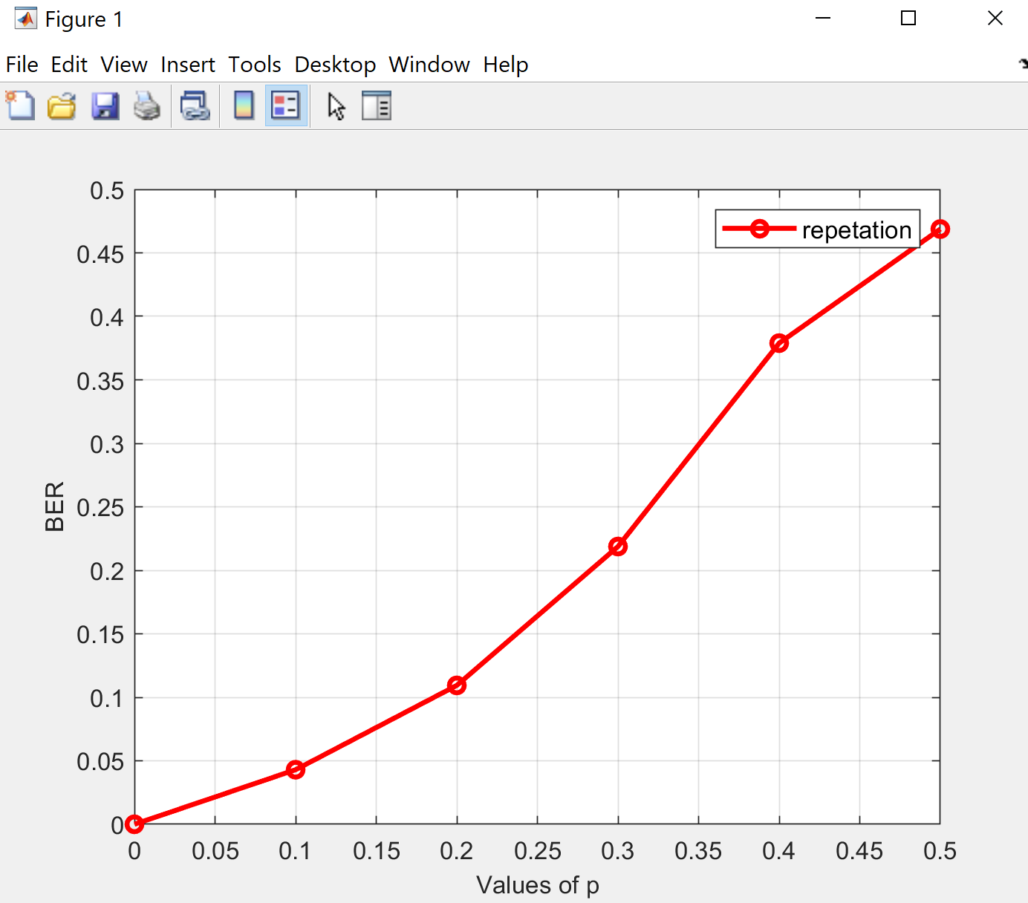
BER with p

Slide 43
convolution code
is a type of error-correcting code that generates parity symbols via the sliding application of a boolean polynomial function to a data stream. The sliding application represents the 'convolution' of the encoder over the data, which gives rise to the term 'convolutional coding'. The sliding nature of the convolutional codes facilitates trellis decoding using a time-invariant trellis. Time invariant trellis decoding allows convolutional codes to be maximum-likelihood soft-decision decoded with reasonable complexity

Slide 44
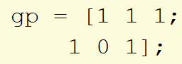
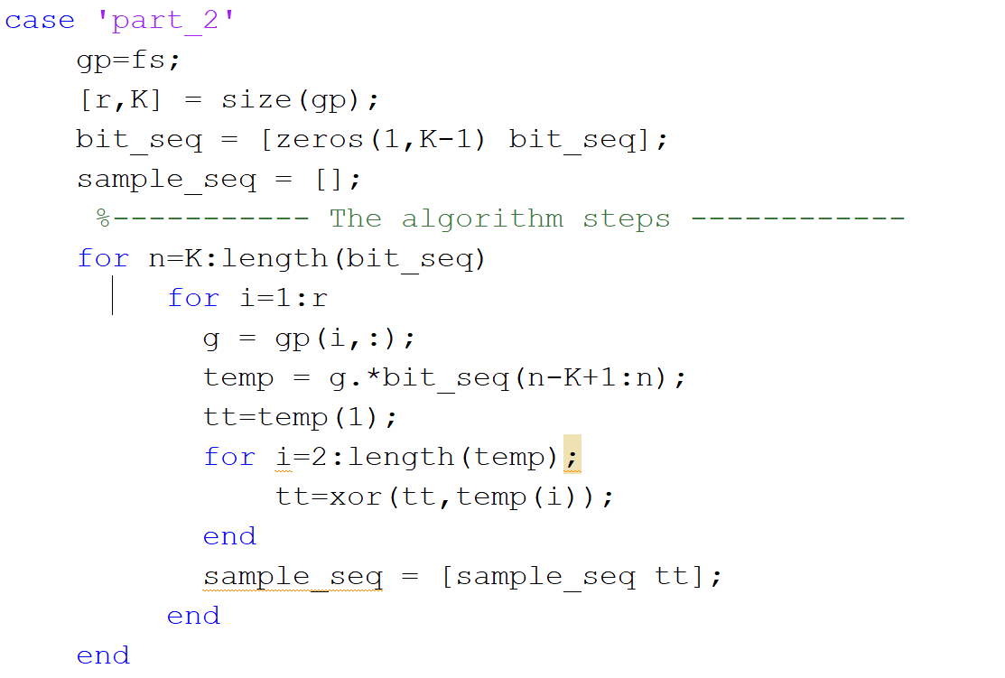
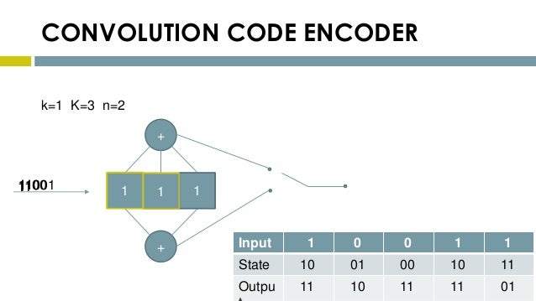
encoder

Slide 45
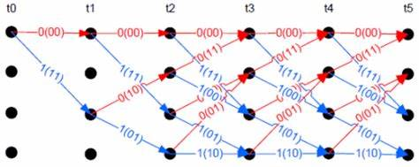
Decoding
A Viterbi decoder uses the Viterbi algorithm for decoding a bitstream that has been encoded using a convolutional code or trellis code.
There are other algorithms for decoding a convolutionally encoded stream (for example, the Fano algorithm). The Viterbi algorithm is the most resource-consuming, but it does the maximum likelihood decoding. It is most often used for decoding convolutional codes with constraint lengths k≤3, but values up to k=15 are used in practice.

Slide 46
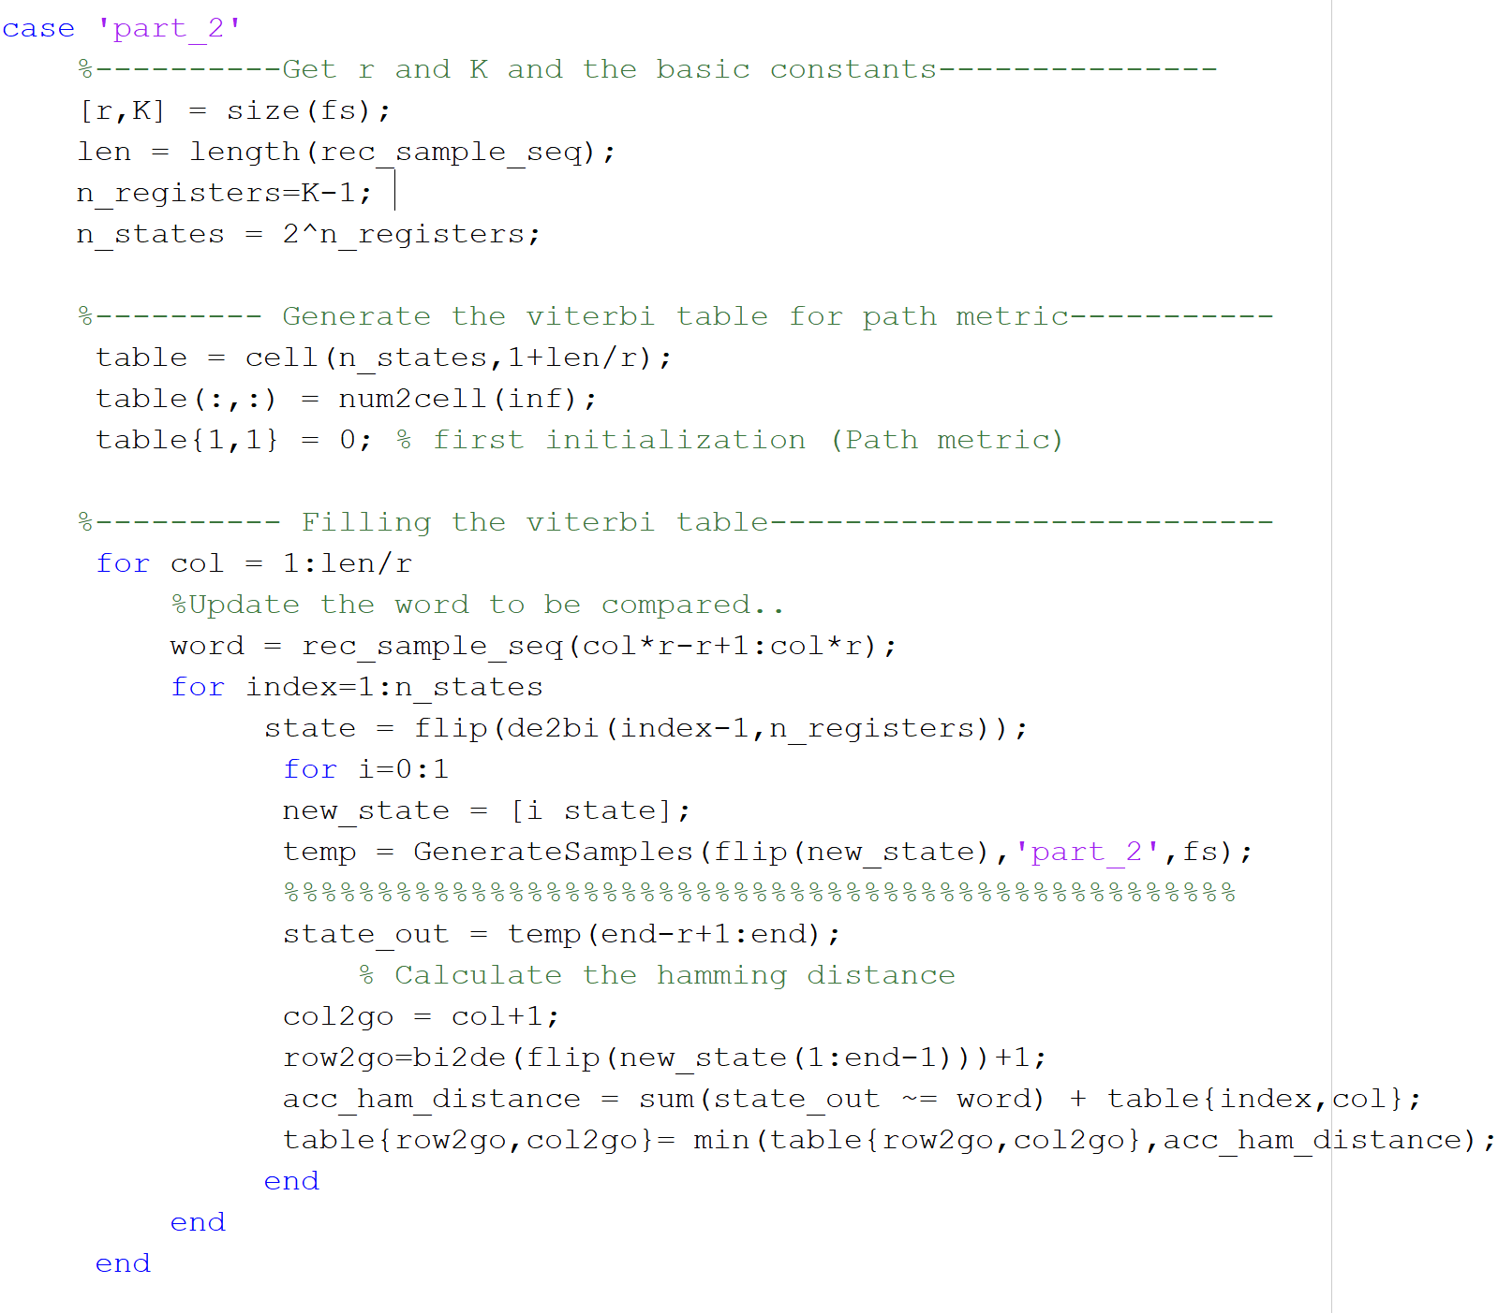
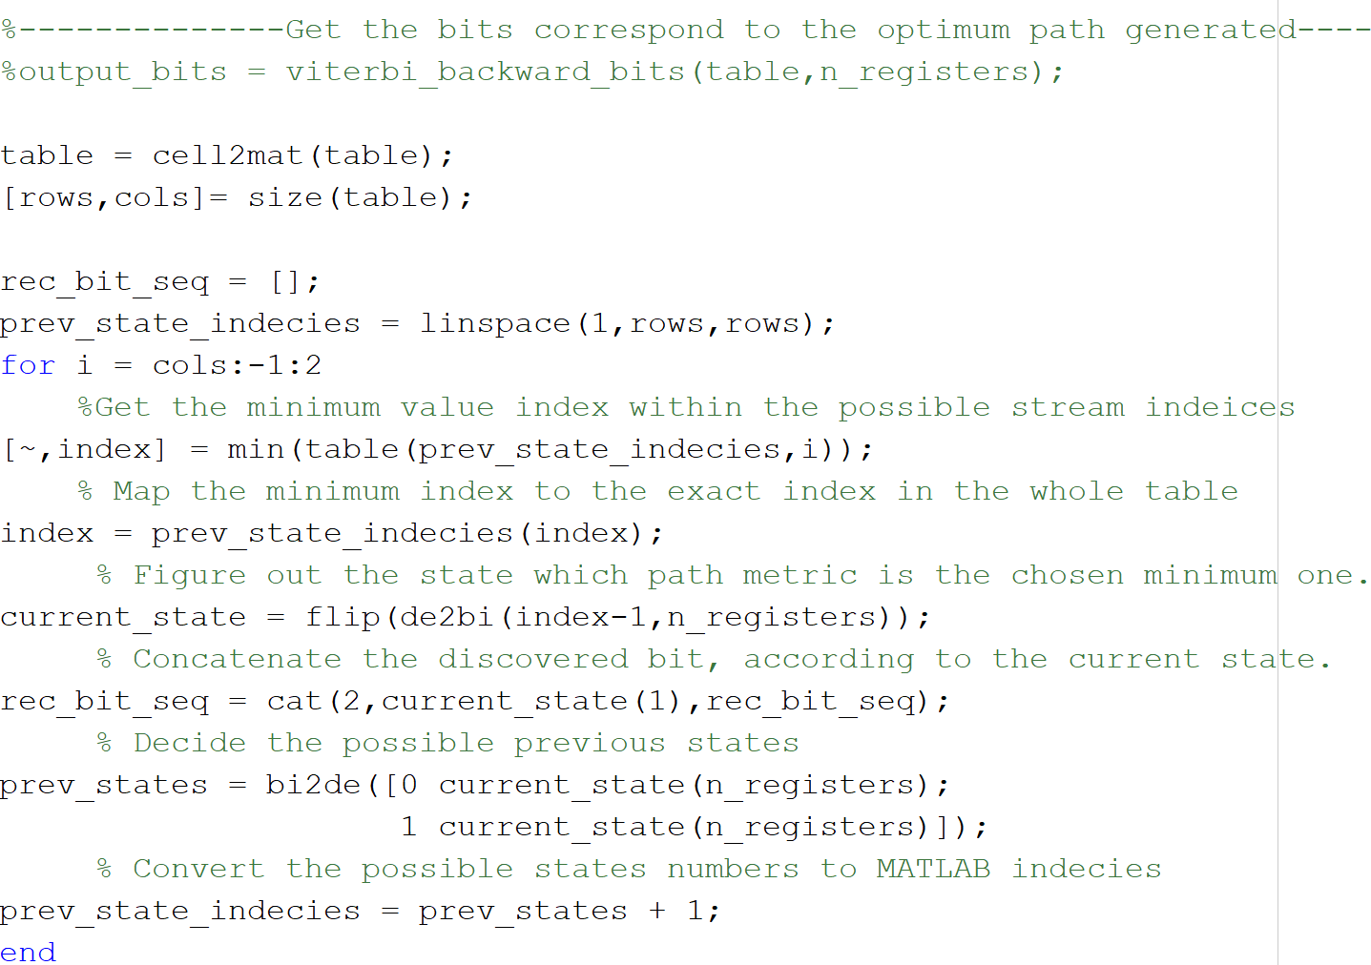
decoder

Slide 47
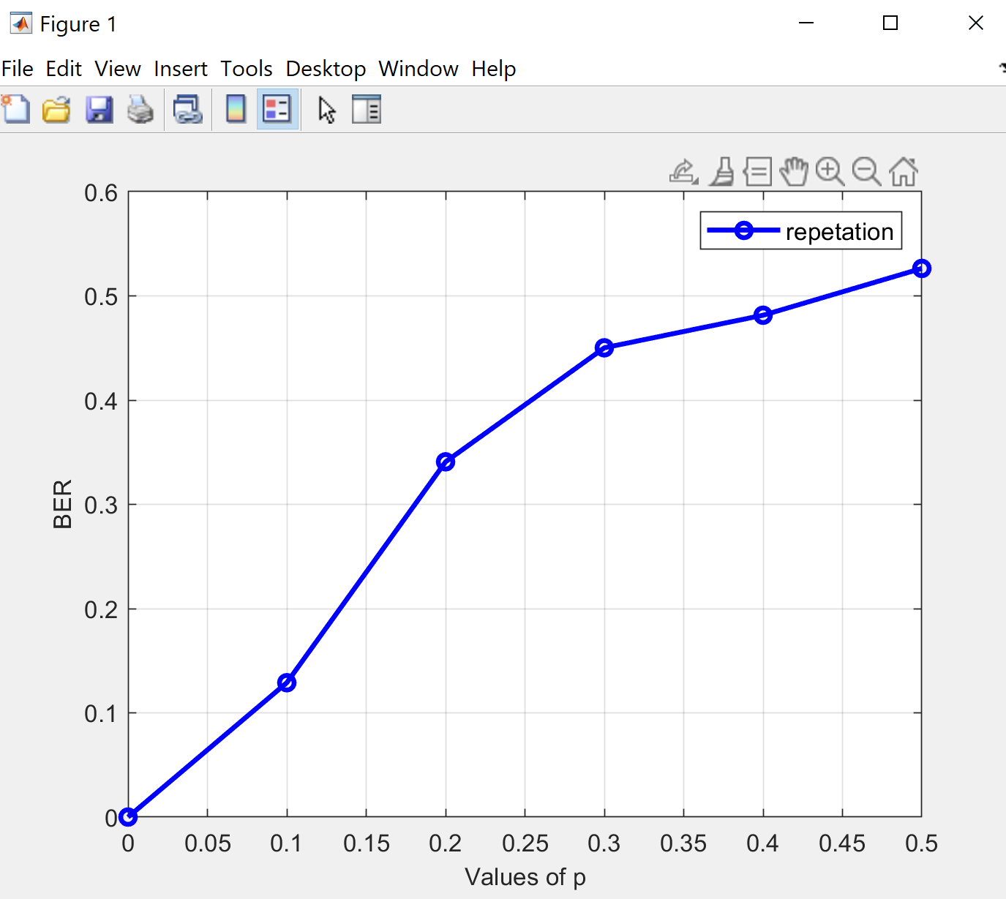
BER with P

Slide 48
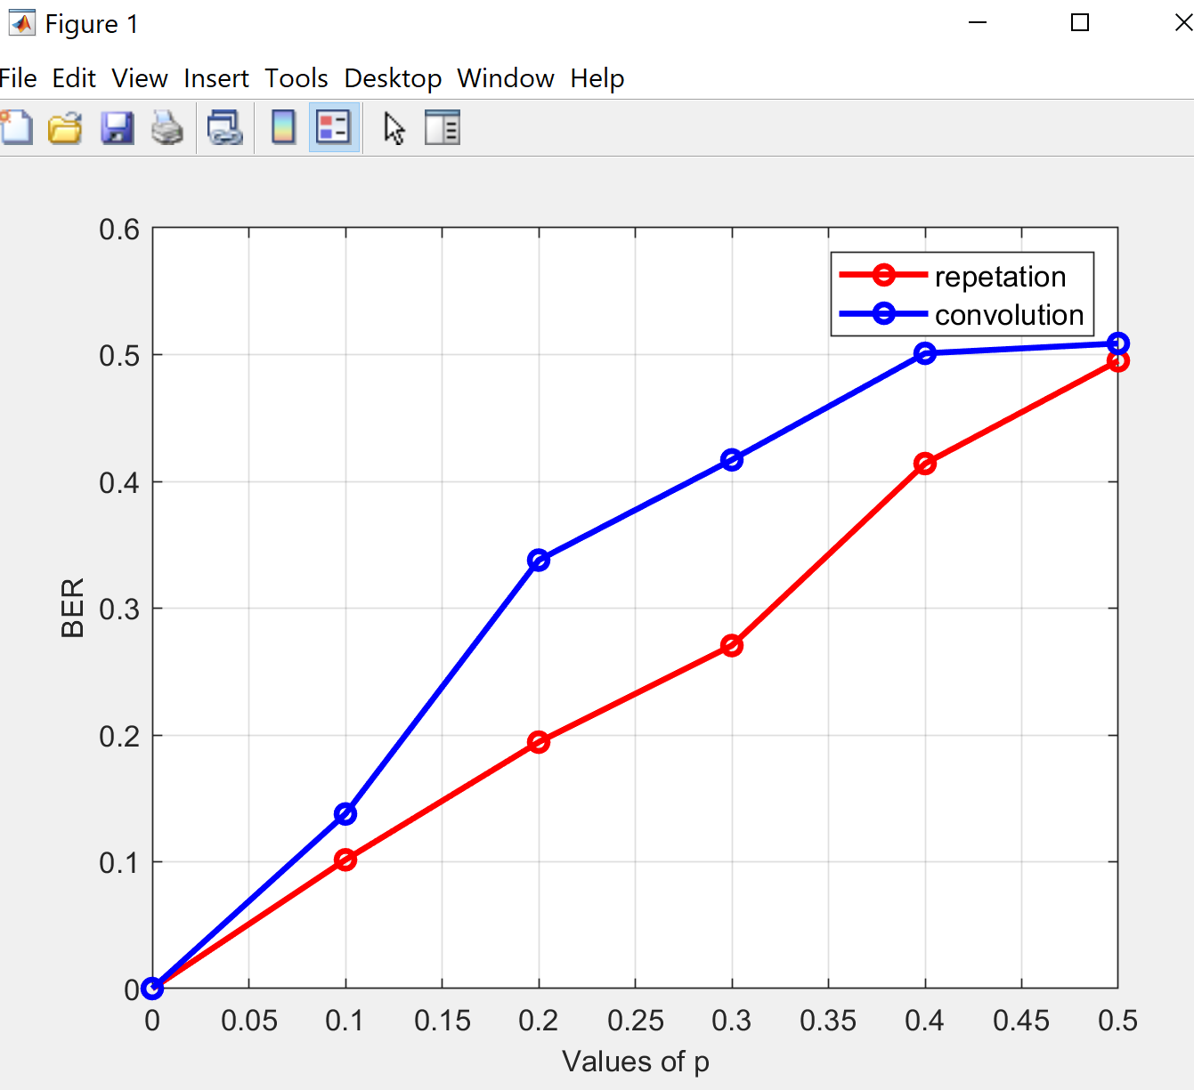
BER with P repetation -convolution

Slide 49
POLAR Codes

